Slide 1
HTTP METHODS
BEST PRACTICES

Slide 2
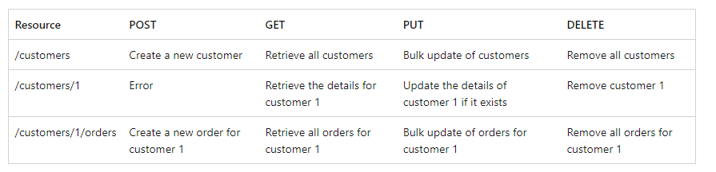
Define API operations in terms of HTTP methods
The HTTP protocol defines a number of methods that assign semantic meaning to a request. The common HTTP methods used by most RESTful web APIs are:
GET retrieves a representation of the resource at the specified URI. The body of the response message contains the details of the requested resource.
POST creates a new resource at the specified URI. The body of the request message provides the details of the new resource. Note that POST can also be used to trigger operations that don't actually create resources.
PUT either creates or replaces the resource at the specified URI. The body of the request message specifies the resource to be created or updated.
PATCH performs a partial update of a resource. The request body specifies the set of changes to apply to the resource.
DELETE removes the resource at the specified URI.
The effect of a specific request should depend on whether the resource is a collection or an individual item. The following table summarizes the common conventions adopted by most RESTful implementations using the e-commerce example. Not all of these requests might be implemented—it depends on the specific scenario.

Slide 3
Conform to HTTP Semantics
This section describes some typical considerations for designing an API that conforms to the HTTP specification. However, it doesn't cover every possible detail or scenario. When in doubt, consult the HTTP specifications.

Slide 4
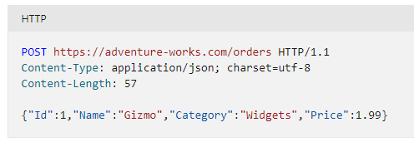
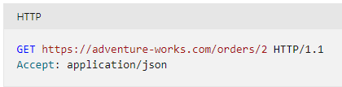
Media Types
As mentioned earlier, clients and servers exchange representations of resources. For example, in a POST request, the request body contains a representation of the resource to create. In a GET request, the response body contains a representation of the fetched resource.
In the HTTP protocol, formats are specified through the use of media types, also called MIME types. For non-binary data, most web APIs support JSON (media type = application/json) and possibly XML (media type = application/xml).
The Content-Type header in a request or response specifies the format of the representation. Here is an example of a POST request that includes JSON data:
If the server doesn't support the media type, it should return HTTP status code 415 (Unsupported Media Type).
A client request can include an Accept header that contains a list of media types the client will accept from the server in the response message. For example:
If the server cannot match any of the media type(s) listed, it should return HTTP status code 406 (Not Acceptable).

Slide 5
API End Point with GET Methods
Used primary for Read resource operations.
A successful GET method typically returns HTTP status code 200 (OK). If the resource cannot be found, the method should return 404 (Not Found).
If the request was fulfilled but there is no response body included in the HTTP response, then it should return HTTP status code 204 (No Content); for example, a search operation yielding no matches might be implemented with this behaviour.
Return Status Code:
200 OK if the response contains data
204 No Content if the response contains no data

Slide 6
API End Point with PUT Methods
Used for Update resource operations.
If a PUT method creates a new resource, it returns HTTP status code 201 (Created), as with a POST method. If the method updates an existing resource, it returns either 200 (OK) or 204 (No Content). In some cases, it might not be possible to update an existing resource. In that case, consider returning HTTP status code 409 (Conflict).
Consider implementing bulk HTTP PUT operations that can batch updates to multiple resources in a collection. The PUT request should specify the URI of the collection, and the request body should specify the details of the resources to be modified. This approach can help to reduce chattiness and improve performance.
Return Status Code:
200 OK if the response contains data
204 No Content if the response contains no data

Slide 7
API End Point with DELETE Methods
Used for Delete resource operations.
If the delete operation is successful, the web server should respond with HTTP status code 204 (No Content), indicating that the process has been successfully handled, but that the response body contains no further information. If the resource doesn't exist, the web server can return HTTP 404 (Not Found).
Return Status Code:
204 No Content for successful delete operation

Slide 8
API End Point with PATCH Methods
Used for Partial update resource operations.
Return Status Code:
200 OK for successful partial update operation.

Slide 9
Request Response Model
HTTP Response status messages
Code | Meaning | Description
200 | OK | The request is OK (this is the standard response for successful HTTP requests)
201 | Created | The request has been fulfilled, and a new resource is created
202 | Accepted | The request has been accepted for processing, but the processing has not been completed
203 | Non-Authoritative Information | The request has been successfully processed, but is returning information that may be from another source
204 | No Content | The request has been successfully processed, but is not returning any content
205 | Reset Content | The request has been successfully processed, but is not returning any content, and requires that the requester reset the document view
206 | Partial Content | The server is delivering only part of the resource due to a range header sent by the client
400 | Bad Request | The request cannot be fulfilled due to bad syntax
401 | Unauthorized | The request was a legal request, but the server is refusing to respond to it.
403 | Forbidden | The request was a legal request, but the server is refusing to respond to it
404 | Not Found | The requested page could not be found but may be available again in the future

Slide 10
Request Response Model
HTTP Response status messages
Code | Meaning | Description
405 | Method Not Allowed | A request was made of a page using a request method not supported by that page
408 | Request Timeout | Request Timeout
500 | Internal Server Error | A generic error message, given when no more specific message is suitable
502 | Bad Gateway | The server was acting as a gateway or proxy and received an invalid response from the upstream server
503 | Service Unavailable | The server is currently unavailable (overloaded or down)

